Slide 1

6th Grade Accelerated Math
Unit 4, Lesson 4 Distance on the Coordinate Plane Volume 1, pg. 151

Slide 2



Benchmark
MA.6.GR.1.2
Find distances between ordered pairs, limited to the same $x$-coordinate or the same $y$-coordinate, represented on the coordinate plane.
volume 1, pg. 151

Slide 3
Integrated Mathematical Thinking and Reasoning Standards
MA.K12.MTR.1.1 Actively participate in effortful learning both individually and collectively.
MA.K12.MTR.4.1 Engage in discussions that reflect on the mathematical thinking of self and others.
MA.K12.MTR.5.1 Use patterns and structure to help understand and connect mathematical concepts.
volume 1, pg. 151

Slide 4

Learning Target
I can find the distance between two ordered pairs.
volume 1, pg. 151

Slide 5

Warm-Up
volume 1, pg. 151

Slide 6
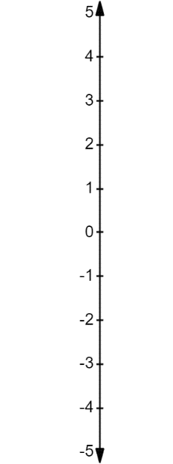
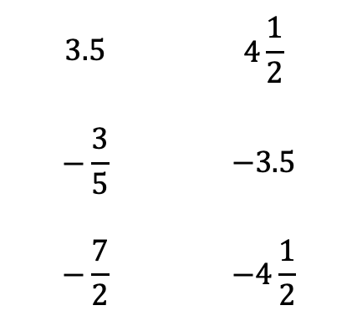
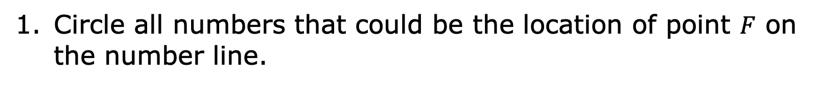
4.4.1 Warm-Up: A Point on the Number Line
Circle all numbers that could be the location of point $F$ on the number line.
$$3.5$$ | $$4\frac{1}{2}$$
$$−\frac{3}{5}$$ | $$−3.5$$
$$−\frac{7}{2}$$ | $$−4\frac{1}{2}$$
F
volume 1, pg. 151

Slide 7

Collaboration
volume 1, pg. 152

Slide 8

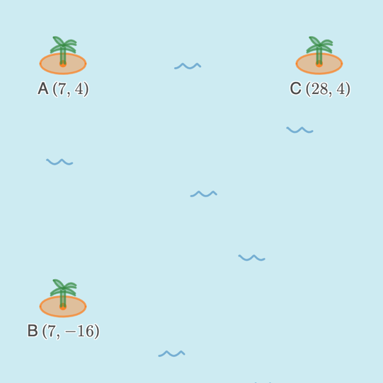
4.4.2 Collaboration: Who is Correct?
The locations of three islands in the ocean are given using ordered pairs.
volume 1, pg. 152

Slide 9
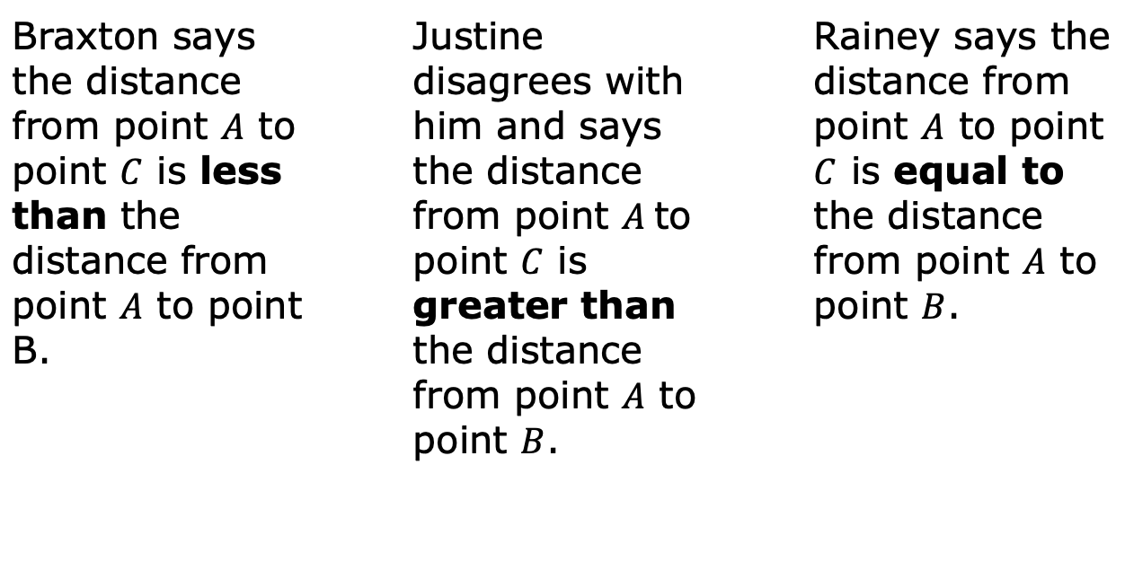
Three students described the distance between each island.
Braxton says the distance from point $A$ to point $C$ is less than the distance from point $A$ to point B. |  | Justine disagrees with him and says the distance from point $A$to point $C$ is greater than the distance from point $A$ to point $B$. |  | Rainey says the distance from point $A$ to point $C$ is equal to the distance from point $A$ to point $B$.
Discuss with your partner who you think is correct. Write a summary of your discussion.
volume 1, pg. 152

Slide 10

Guided Instruction
volume 1, pg. 153

Slide 11
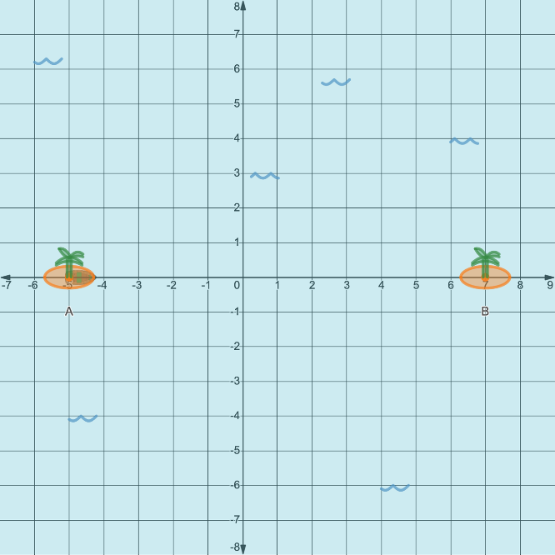
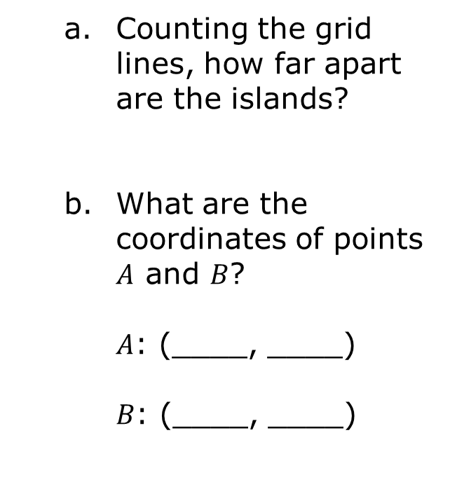

4.4.3 Guided Instruction: Distance on the Coordinate Plane
The coordinates of two small islands are labeled points $A$ and $B$ on the graph.
Counting the grid lines, how far apart are the islands?
What are the coordinates of points $A$ and $B$?
$A$: (____, ____)
$B$: (____, ____)
volume 1, pg. 153

Slide 12
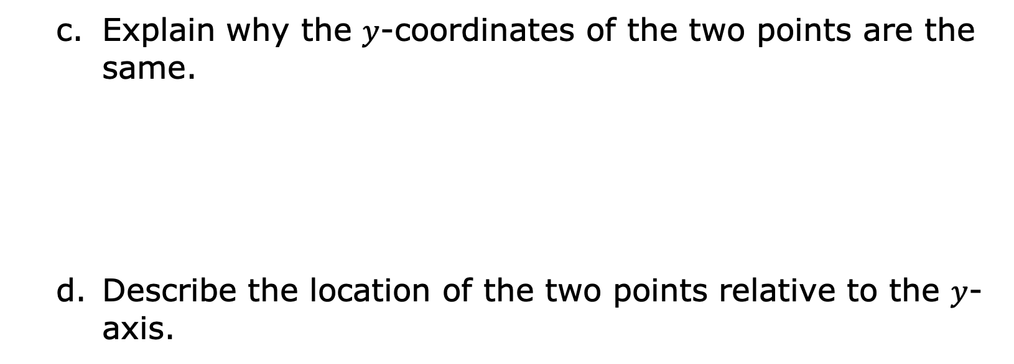
Explain why the $y$-coordinates of the two points are the same.
Describe the location of the two points relative to the $y$-axis.
volume 1, pg. 153

Slide 13

The distance a number is from zero (0) on a number line is called the absolute value.
volume 1, pg. 153

Slide 14
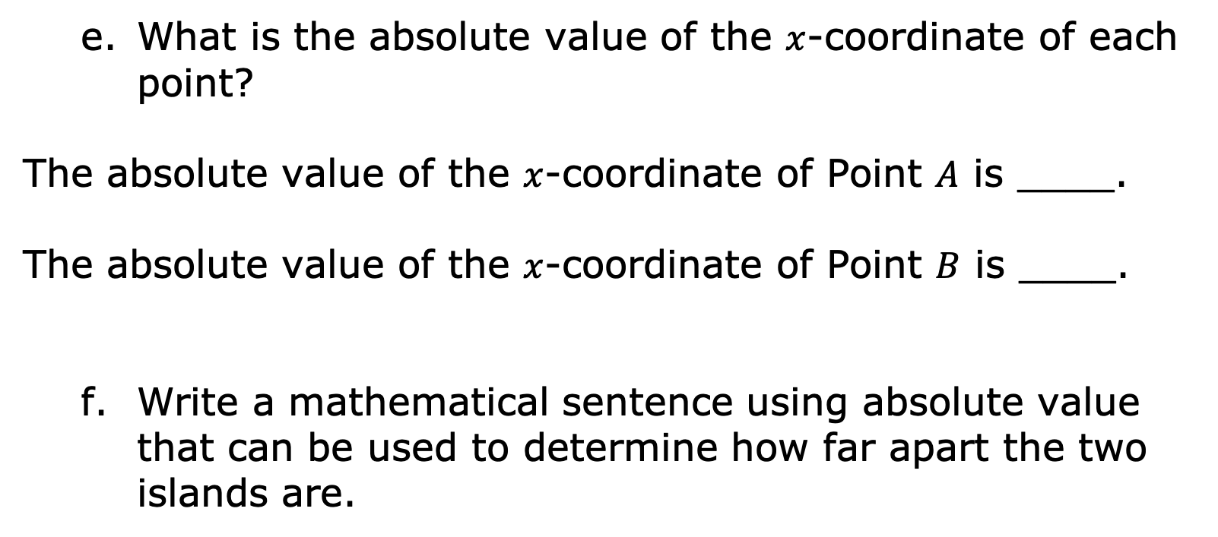
What is the absolute value of the $x$-coordinate of each point?
The absolute value of the $x$-coordinate of Point $A$ is ____.
The absolute value of the $x$-coordinate of Point $B$ is ____.
Write a mathematical sentence using absolute value that can be used to determine how far apart the two islands are.
volume 1, pg. 153

Slide 15
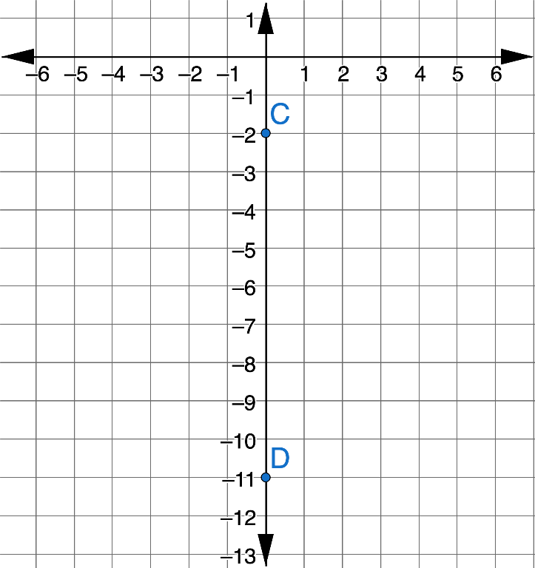

Below is another coordinate plane with two different islands located at points $C$ and $D$.
How is the location of these two islands different from the first two you worked with?
Counting the grid lines, how far apart are the islands?
volume 1, pg. 154

Slide 16
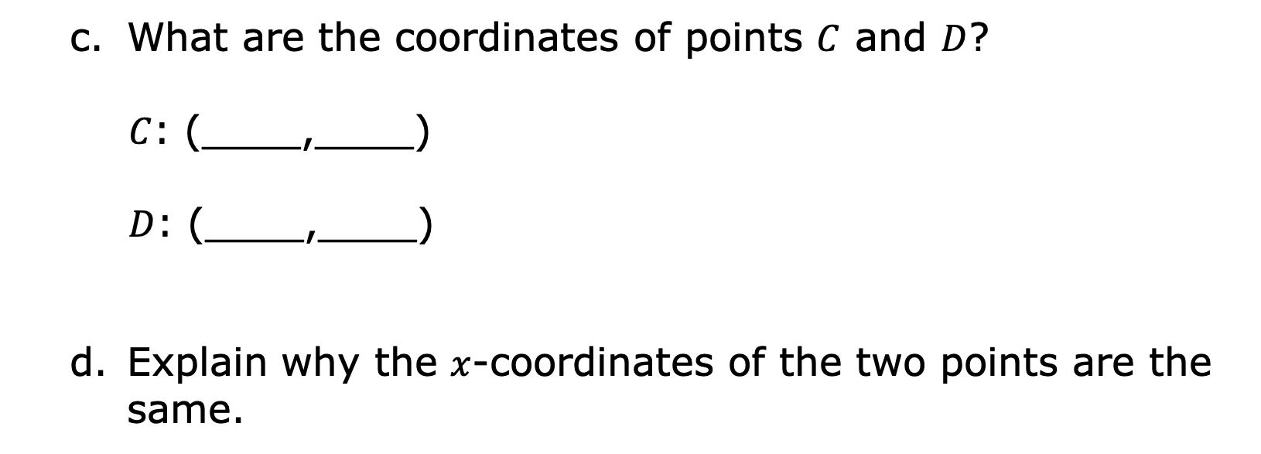
What are the coordinates of points $C$ and $D$?
$C$: (____,____)
$D$: (____,____)
Explain why the $x$-coordinates of the two points are the same.
volume 1, pg. 154

Slide 17
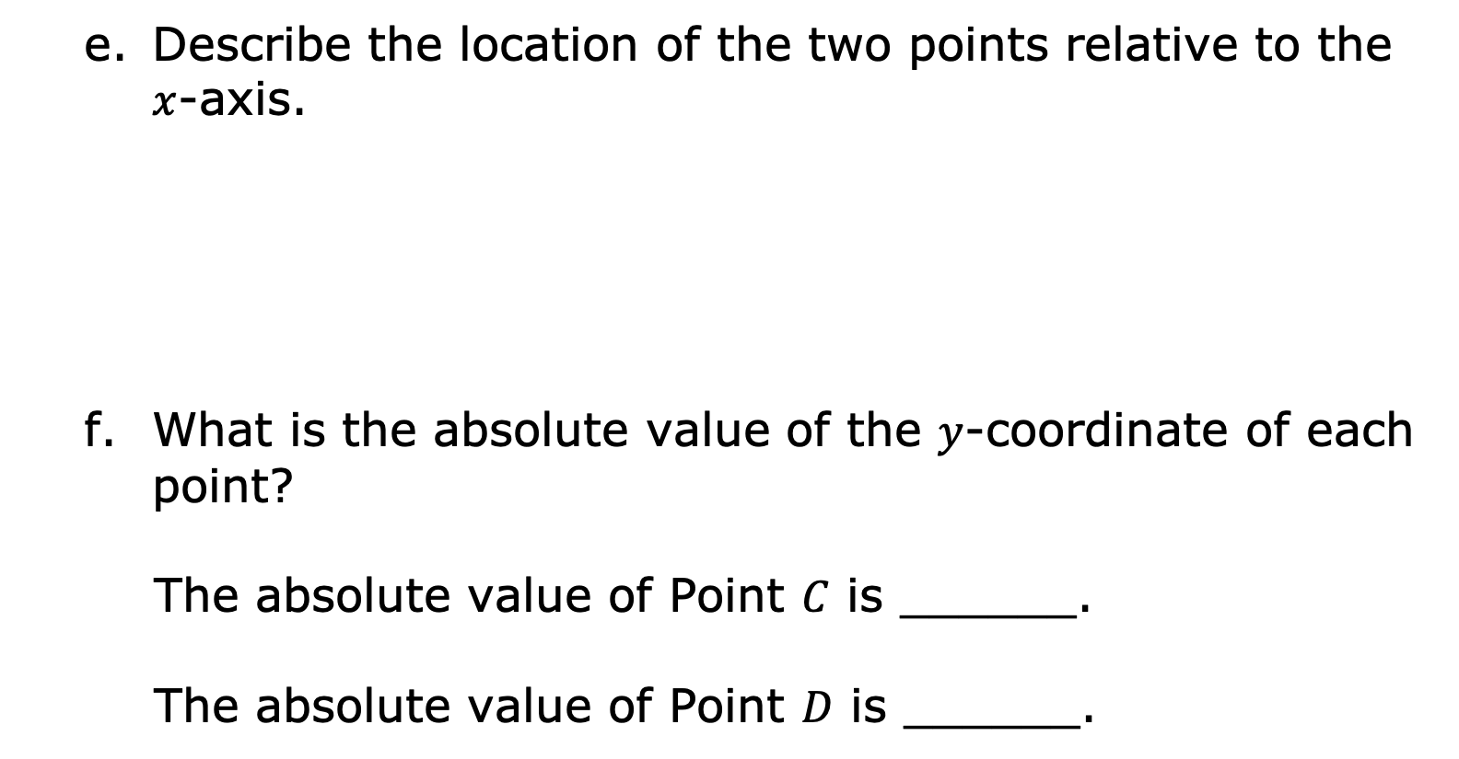
Describe the location of the two points relative to the $x$-axis.
What is the absolute value of the $y$-coordinate of each point?
The absolute value of Point $C$ is ______.
The absolute value of Point $D$ is ______.
volume 1, pg. 154

Slide 18
Write a mathematical sentence using absolute value that can be used to determine how far apart the two islands are.
volume 1, pg. 154

Slide 19
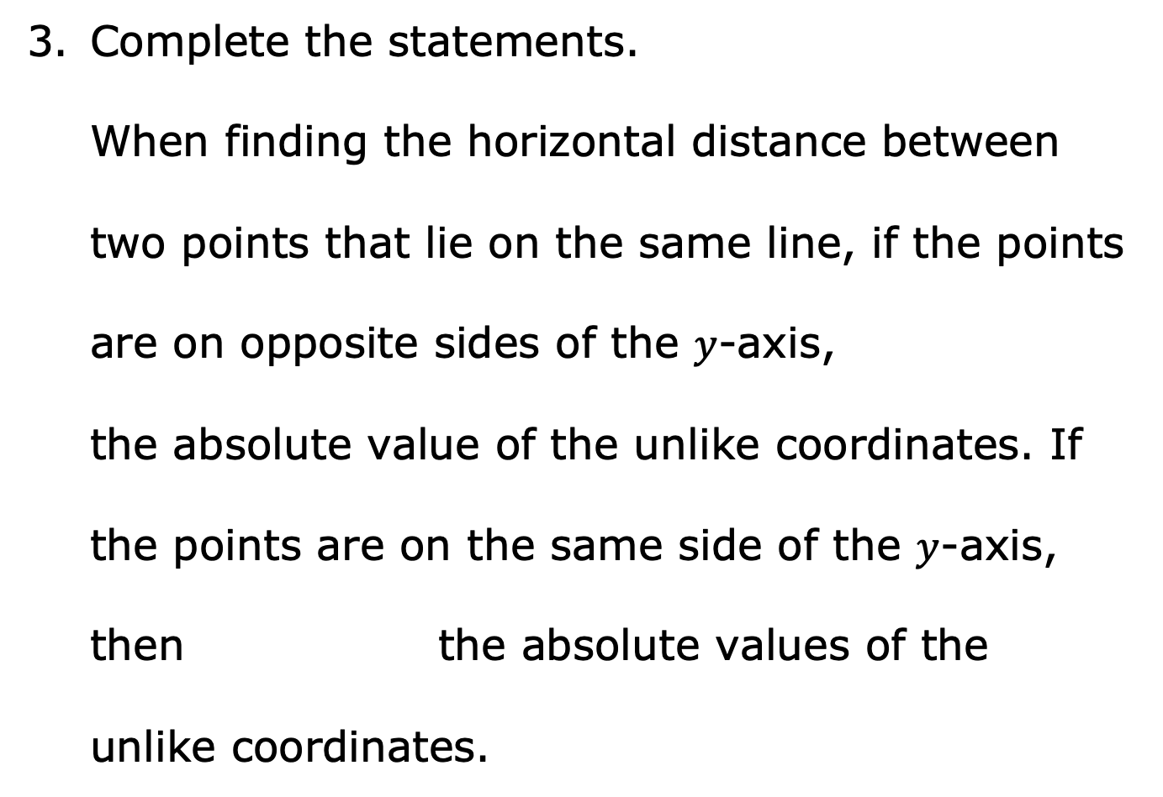
Complete the statements.
When finding the horizontal distance between
two points that lie on the same line, if the points
are on opposite sides of the $y$-axis,
the absolute value of the unlike coordinates. If
the points are on the same side of the $y$-axis,
then the absolute values of the
unlike coordinates.
add
subtract
add
subtract
volume 1, pg. 155

Slide 20
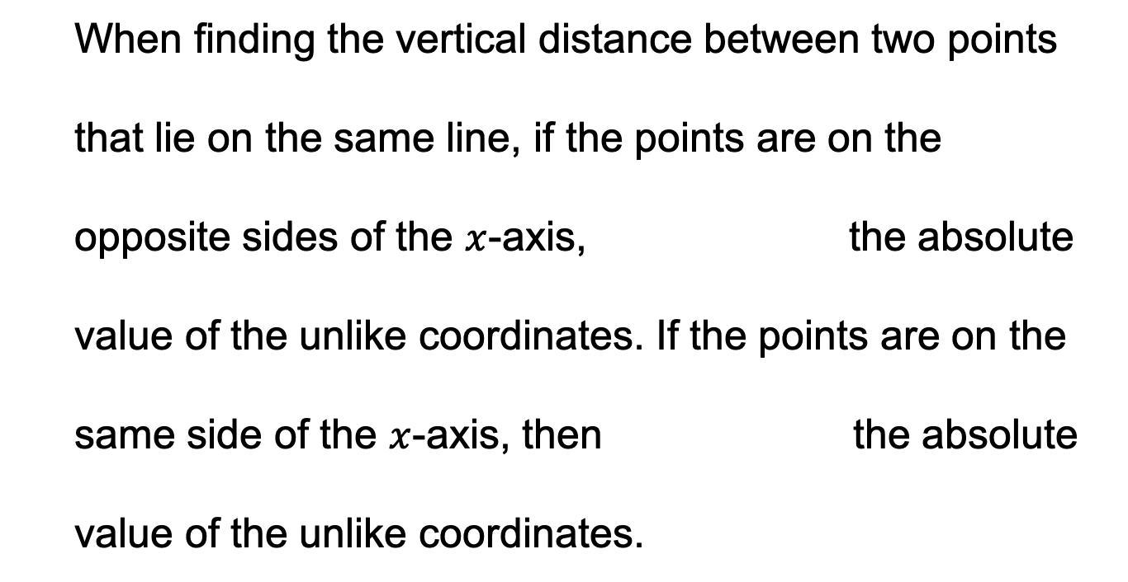
When finding the vertical distance between two points
that lie on the same line, if the points are on the
opposite sides of the $x$-axis, the absolute
value of the unlike coordinates. If the points are on the
same side of the $x$-axis, then the absolute
value of the unlike coordinates.
add
subtract
add
subtract
volume 1, pg. 155

Slide 21

Guided Practice
volume 1, pg. 155

Slide 22

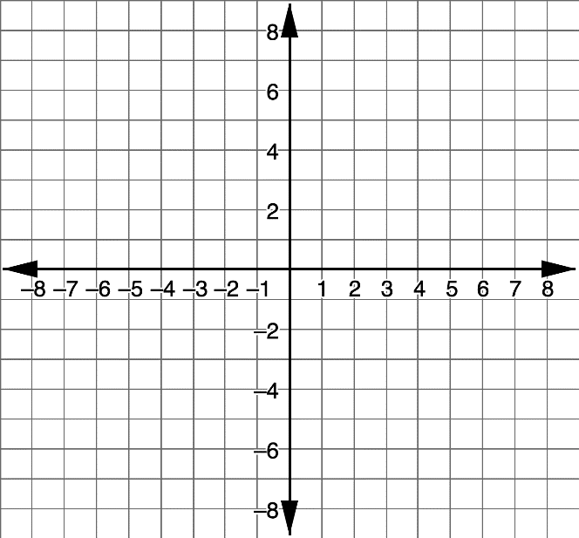
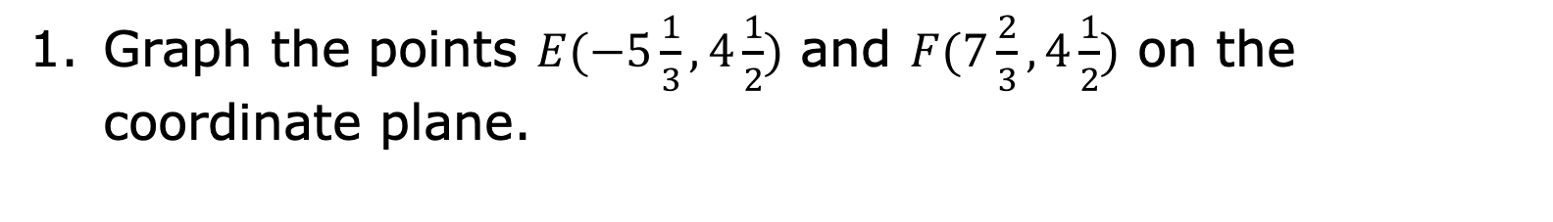
4.4.4 Guided Practice: Distances Between Rational Numbers
Graph the points $E(−5\frac{1}{3}, 4\frac{1}{2})$ and $F(7\frac{2}{3}, 4\frac{1}{2})$ on the coordinate plane.
volume 1, pg. 155

Slide 23
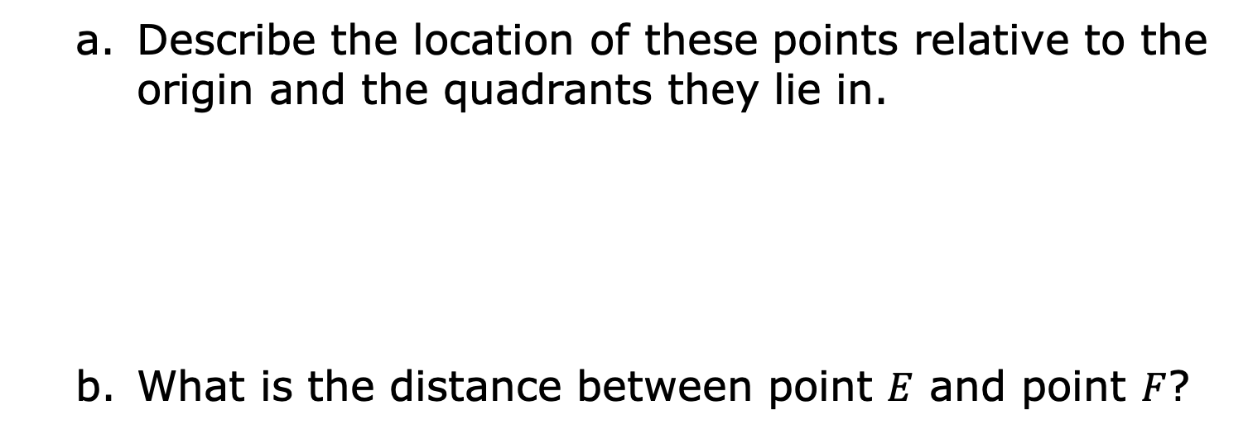
Describe the location of these points relative to the origin and the quadrants they lie in.
What is the distance between point $E$ and point $F$?
volume 1, pg. 155

Slide 24
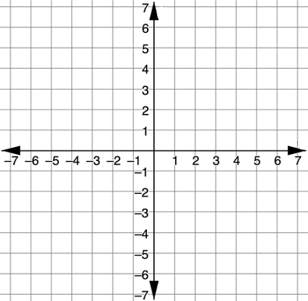
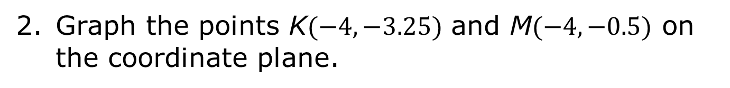
Graph the points K$(−4, −3.25)$ and M$(−4, −0.5)$ on the coordinate plane.
volume 1, pg. 156

Slide 25
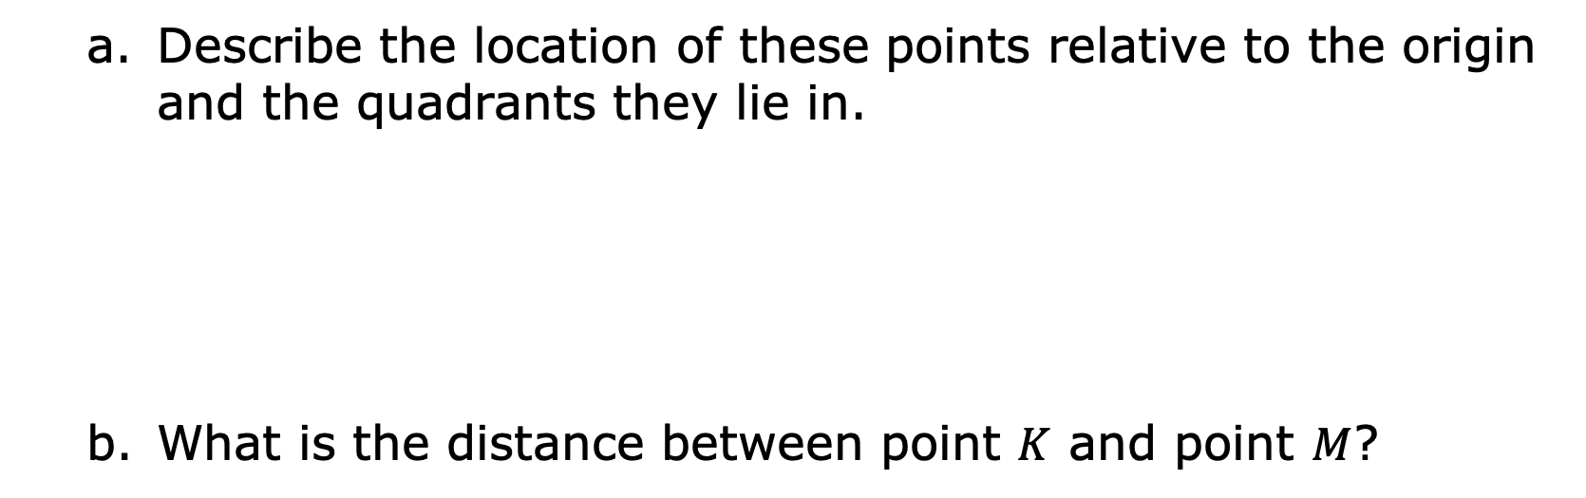
Describe the location of these points relative to the origin and the quadrants they lie in.
What is the distance between point $K$ and point $M$?
volume 1, pg. 156

Slide 26

Your Turn
volume 1, pg. 156

Slide 27
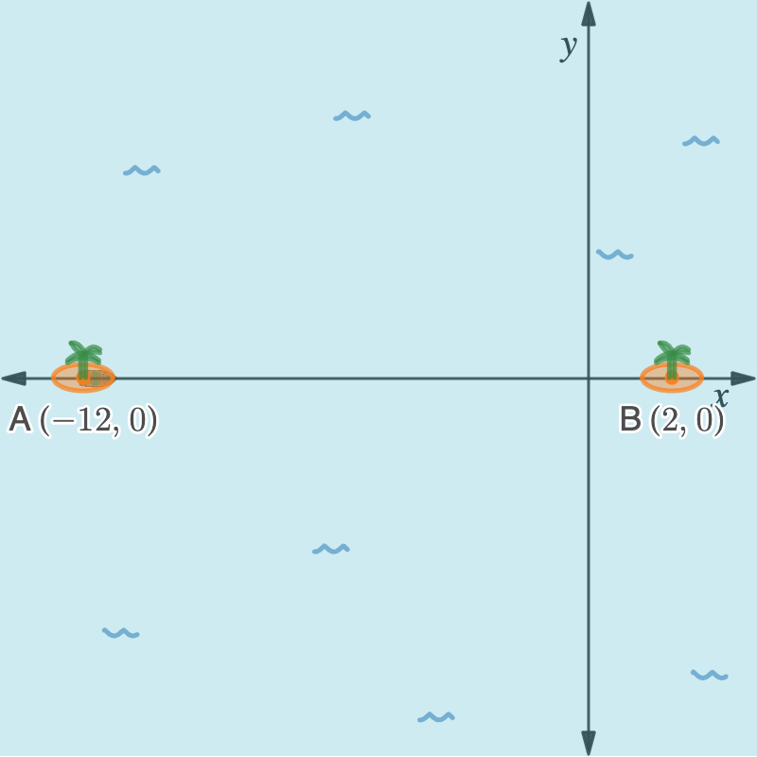
4.4.5 Your Turn!
What is the distance from point $A$ to point $B$?
volume 1, pg. 156

Slide 28

Explain which island is closest to island $A$. Show your work.
volume 1, pg. 157

Slide 29
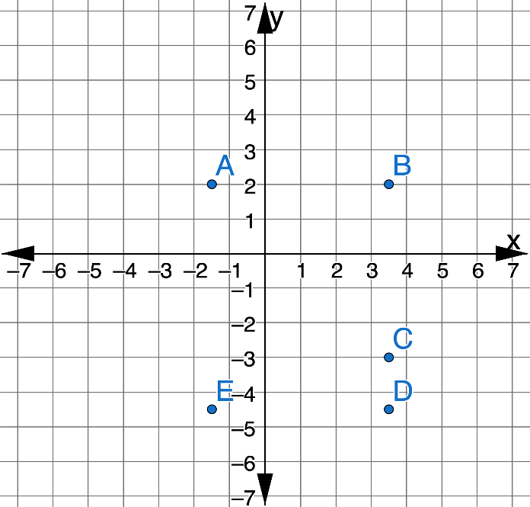
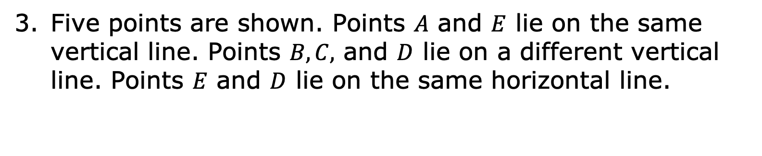
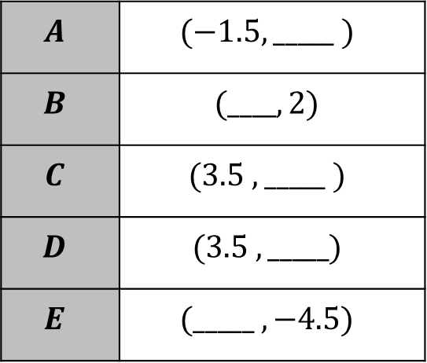
Five points are shown. Points $A$ and $E$ lie on the same vertical line. Points $B, C,$ and $D$ lie on a different vertical line. Points $E$ and $D$ lie on the same horizontal line.
Complete the table by filling in each missing coordinate.
$$A$$ | $$(−1.5, _____ )$$
$$B$$ | $$(____, 2)$$
$$C$$ | $$(3.5 , _____ )$$
$$D$$ | $$(3.5 , _____)$$
$$E$$ | $$(_____ , −4.5)$$
volume 1, pg. 157

Slide 30
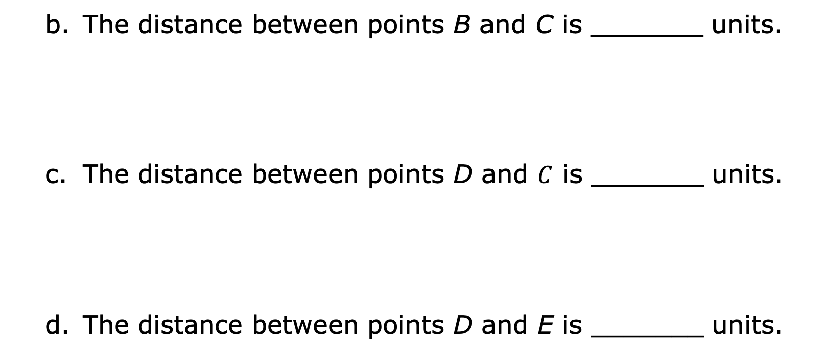
The distance between points B and C is _______ units.
The distance between points D and $C$ is _______ units.
The distance between points D and E is _______ units.
volume 1, pg. 157

Slide 31
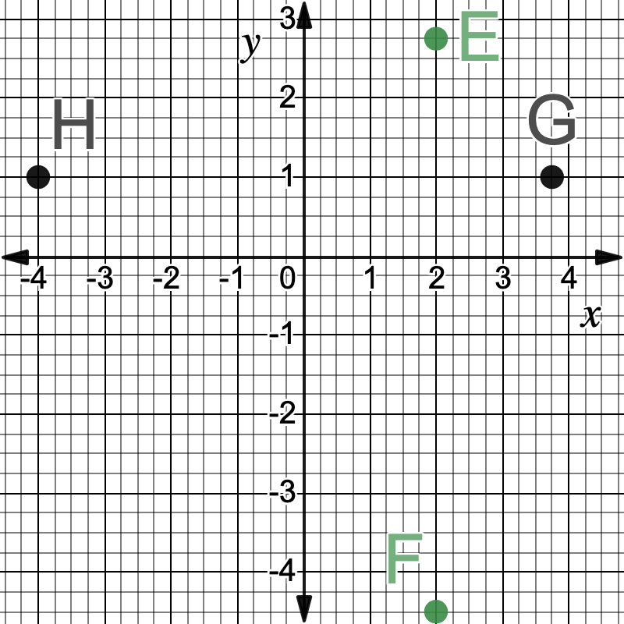
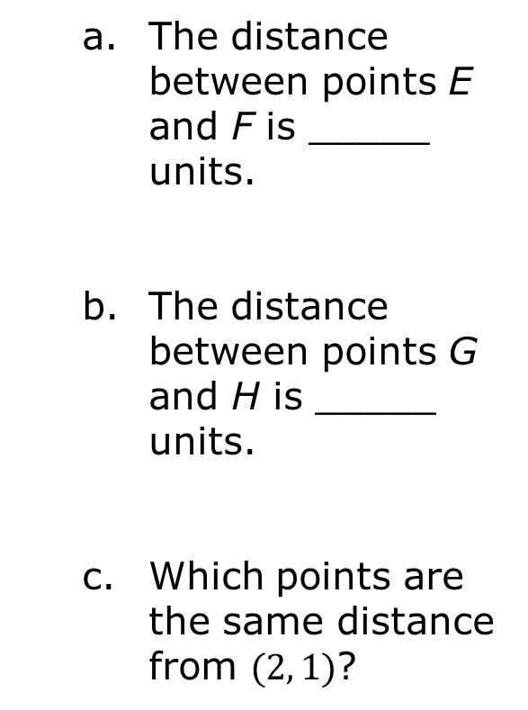
Use the coordinate plane below to determine distances between the following points.
The distance between points E and F is _____ units.
The distance between points G and H is _____ units.
Which points are the same distance from $(2, 1)$?
volume 1, pg. 158

Slide 32

Wrap-Up
volume 1, pg. 158

Slide 33
4.4.6 Wrap-Up: Cool Down
Your friend is absent today and will need the notes from class. Write a quick note to help them learn how to find the distance between two points on a coordinate plane.
volume 1, pg. 158

